Slide 1
Introduction and installation
Lecture 1

Slide 2
Geant4 – what it is
Toolkit for simulation of particle passing through matter
Written in C++ and requires C++ knowledge to use
Roughly – a large amount of prewritten C++ classes to use in your own code
It is not a standalone simulation program like TRIM, SIMION or LISE++
Has a lot of its own prewritten processes describing various interactions with built-in cross-sections
Typical uses – detector response and efficiency, particle trajectories in fields, stopping range, energy losses
You can write your own processes and include them in simulation
You can propagate particles in magnetic and electric fields, for static and time-dependent fields
First we need to install it – compile source C++ files into machine code
We do it in order to not recompile huge amount of Geant4 C++ files each time you change your own code!
Also we will install ROOT – not required, but we will use it for plotting results of simulation and extracting data!
As development environment we will use QtCreator!

Slide 3
Important resources
https://geant4.web.cern.ch/docs/ - all official documentation
https://geant4-userdoc.web.cern.ch/UsersGuides/ForApplicationDeveloper/html/index.html - main guide for Geant4 applications development
https://geant4-userdoc.web.cern.ch/UsersGuides/PhysicsListGuide/html/index.html - Physics lists guide
https://geant4-userdoc.web.cern.ch/UsersGuides/PhysicsReferenceManual/fo/PhysicsReferenceManual.pdf - description of all physics implemented in Geant4

Slide 4
Geant4 installation on Windows (but actually on Linux)
Install WSL
Update and upgrade your Linux distro
Install dependencies
Install Geant4
Install QtCreator and configure Geant4
Install ROOT

Slide 5
1. Install WSL
Easiest way to install Geant4 on Windows is to install Linux on your Windows and then install Geant4 :)
WSL - Windows Subsystem for Linux – lets you run fast Linux system on your Windows machine without dual boot
You should have ~ 40 GB free on your C disk (sorry)
Check your Windows version – type winver in PowerShell – needs Windows 10 version 21H2+ (build 19044+) or Windows 11!
You can choose any distro, I will use Ubuntu for this course
Open PowerShell as Administrator:
wsl --list --online – shows all available distros
wsl --install -d Ubuntu-26.04
You can choose other distro if you want:
wsl --install -d AlmaLinux-10 - as an example
After installation, it will ask for a username and password.
Use a relatively easy-to-type password – you will need to type it quite a lot!
Reboot Windows after installation is finished!

Slide 6
What if WSL is unavailable to you
You can try to install Linux directly, it's quite user-friendly in 2026! You can dual boot and instruction will be the same
You can connect to some Linux machine at your work through ssh and do the same
Virtual machines - slower than WSL but alright. Check VMware Workstation Pro or VirtualBox. Still will need 40-50 GB of space and 8+ GB of RAM!
You can try to install Geant4 and ROOT directly on Windows using Visual Studio 2022 - it is possible, but I’ve never done it, good luck :)

Slide 7
2. Update and upgrade your Linux distro
Most Linux distros are automatically connected to secure online repositories
From them you can receive updates for your system and download required libraries directly from terminal
When Linux asks for your password in the terminal, nothing appears while you type - not even ***** - it’s okay!
sudo — run this command with administrative privileges. Use it when a command needs system-wide access(like for installing packages). It will ask password!
sudo apt update – refreshes package list, “apt” – is for Ubuntu (Debian-based distro), other distros can use “dnf”/”yum” – AlmaLinux as example
sudo apt upgrade – updates installed packages. It will typically show you how much space it will require and what libraries will be updated and will ask your permission
Your WSL is your separate Linux system, connected to the Internet, so better to keep it updated!

Slide 8
3. Install dependencies
We will install all required libraries for Geant4 first
sudo apt install -y cmake g++ gcc build-essential qt6-base-dev libqt6opengl6-dev qt6-base-dev-tools libxmu-dev libx11-dev git wget cmake-curses-gui libexpat1-dev libxerces-c-dev
Don't worry too much about what all of them do, some are compilers – for translation of C++ in machine code, some are visualization libraries, some for building projects, etc

Slide 9
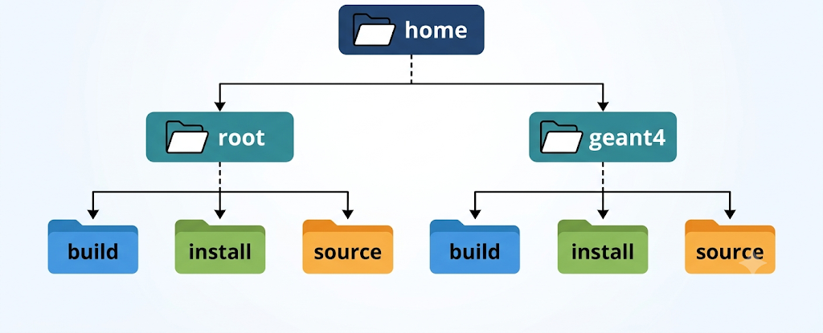
4. Install Geant4
We will build Geant4 from source
First we will create 3 folders – source, build, install
source – Geant4 source files with C++ code
build – here we configure Geant4 options (via ccmake) and compile the C++ code into machine code
install – the final folder in which your Geant4 files will be, headers, libraries, datasets and tools that our Geant4 applications will use
Idea is to keep installation clean and easy to reinstall and relink – Geant4 is frequently updated!
In terminal:
cd ~ cd – change directory, ~ - shortcut to your home directory
mkdir geant4 mkdir – make directory
cd geant4
mkdir build You can use TAB for autocompletion for a lot of commands!
mkdir install ls – list directories and files
mkdir source rm -rf ./foldername – remove folder or file.
No Recycle Bin, so be careful!

Slide 10
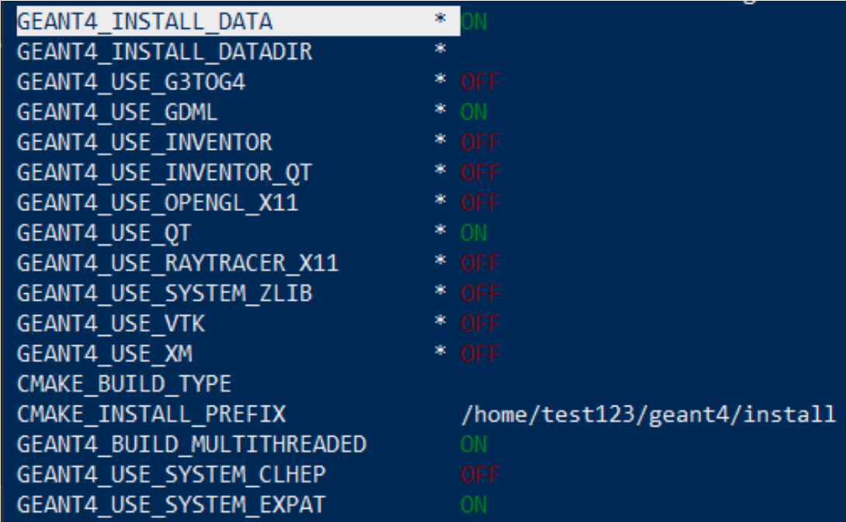
4. Install Geant4
cd source
git clone --branch v11.4.3 --depth=1 https://github.com/Geant4/geant4.git .
We are copying Geant4 version 11.4.3 in current folder using git
. – shortcut for current directory
.. – shortcut for parent directory
cd ../build – we go in build folder
ccmake ../source – we are configuring the Geant4 build
Press C to start build configuration – it will check dependencies, link them and ask desired options
Switch GEANT4_INSTALL_DATA to ON
GEANT4_USE_QT to ON
GEANT4_USE_GDML to ON
Change CMAKE_INSTALL_PREFIX to ~/geant4/install – it should automatically write full directory, use TAB
Check that GEANT4_BUILD_MULTITHREADED is ON
What you should see after pressing C once and
configuring, “test123” – should be your username
Press C, then press C again – there should be no lines with * after that
Press G, window should close. Then type
make -j12 install
12 – max number of parallel compilations which will be used during Geant4 installation, change up to your setup. It typically takes 20-40 minutes depending on your PC!

Slide 11
5. Install QtCreator and configure the Geant4 environment
QtCreator is an IDE – Integrated Development Environment – think like Visual Studio or VS Code
We will install it on our Linux in WSL!
Highlights code, searches for syntax errors, allows debugging, breakpoints, etc.
Allows for CMake projects – this is typical way for Geant4 to prepare simulation
sudo apt install qtcreator
To make Geant4 available automatically in every terminal session, we append its setup scripts to our .bashrc configuration file - .bashrc runs every time you open new terminal
echo "source ~/geant4/install/bin/geant4.sh" >> ~/.bashrc
source ~/.bashrc
This script sets up environment variables with paths to Geant4 files and libraries and allow the QtCreator or any other app to find them!

Slide 12
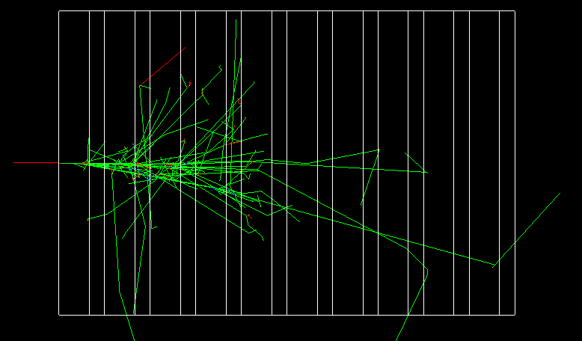
5. Install QtCreator and configure Geant4
Lets try to run Geant basic example
Run QtCreator by typing
qtcreator
Then press File -> Open File or Project
Go to
~/geant4/source/examples/basic/B4/B4a
Choose CMakeLists.txt
You will get a window with build options, for now just press Configure Project on the bottom right
Then press Run on bottom left, green triangle
You should see geometry of an example and get in Geant4 interactive session!
If you see white screen - try to press Left Mouse Button, hold it and wiggle a little bit
Press green icon with white triangle on top panel - you should see some tracks!

Slide 13
What is CMakeLists.txt
CMakeLists.txt is a text file describing how the project should be built!
CMake itself does not compile the code — it prepares the build system. After that, command make runs the compiler and linker to create actual machine code!
For a typical Geant4 project in CmakeLists.txt you describe:
where to find Geant4 files
which .cc files belong to our program
what executable to create
which Geant4 libraries to link to it
optionally: copy macros, data files, geometry files, etc. into the build directory
Usually you only modify CMakeLists.txt when you add source files, libraries, external packages, or files that need to be copied into the build directory!
If you want to create your own project - copy one of CMakeLists.txt from the lecture course and rename project name and file with main!

Slide 14
6. Install ROOT
Same sequence – dependencies, directories, get source, build it with cmake, install
We will use ROOT for data collection in our simulation – histograms, tables, whatever we need
Dependencies:
sudo apt install -y cmake g++ gcc libx11-dev libxpm-dev libxft-dev libxext-dev libssl-dev libgif-dev libjpeg-dev libtiff-dev git wget cmake-curses-gui liblz4-dev libxxhash-dev libpcre2-dev libcrypt-dev libtbb-dev python3-dev libgsl-dev libfftw3-dev libzstd-dev
Some of them were already installed for Geant4!
Directories:
cd ~
mkdir root
cd root
mkdir source build install – can make several folders in one line

Slide 15
6. Install ROOT
cd source
git clone --branch latest-stable --depth=1 https://github.com/root-project/root.git .
Same idea, we copy latest stable ROOT version to source folder
cd ../build
ccmake ../source
Press C
ROOT is much larger, so several screens of options!
Go down using arrow keys
Switch http to OFF
Switch xrootd and builtin-xrootd to OFF – press T for advanced options if you can’t find it
Set CMAKE_INSTALL_PREFIX to ~/root/install, use TAB to autocomplete the path
Press C again, after it finishes, you should see something like:
“Enabled support for: asimage builtin_clang builtin_cling …..
Configuring done (19.6s)”
Press G.
Then the same: make -j12 install – better to do at home, ROOT installation can take up to 3 hours!

Slide 16
Possible problems during installation
If something goes wrong:
Warnings – ok, they most likely do not matter, search for errors in the log
Look for the first actual error: message, not the final make: *** message!
During ccmake ./source – most likely forgot to install some prerequisites, look up the error in the log, copy it and ~30 lines around and ask your favorite LLM
During make -jN install – forgot to disable some options like http, xrootd or builtin-xrootd, look up the error in log, copy it and ~30 lines around and ask your favorite LLM
If build stops with many "Terminated" messages and no clear error — that's RAM running out, reduce thread count and retry

Slide 17
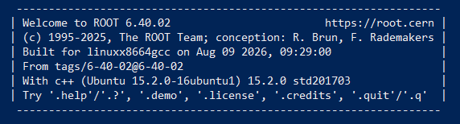
6. Install ROOT
To check the installation – first source the environment variables in the same manner as Geant4:
echo "source ~/root/install/bin/thisroot.sh" >> ~/.bashrc
source ~/.bashrc
Then type in terminal
root
You should see something like

Slide 18
So, all went well if
Type bold commands in your WSL session:
geant4-config --version - you get 11.4.3
geant4-config --check-datasets - should show INSTALLED
qtcreator - opens correctly, B4a example builds and runs, visualization window opens, shows layers, you can start tracking by pressing green button
root - ROOT prompt opens

Slide 19
Some useful Linux terminal commands and stuff
Command | Description
pwd | Show the full path of the directory you are currently in
ls | Show files and folders in the current directory
cd foldername | Enter foldername inside the current directory
cd ~/geant4/source | Go directly to the folder geant4/source inside your home directory
cd .. | Go one folder up
cd ~ | Go to your home directory, e.g. /home/username
mkdir foldername | Create a new folder called foldername
cp filename.txt newfile.txt | Copy filename.txt and call the copy newfile.txt
cp filename.txt ~/geant4/ | Copy filename.txt into the folder ~/geant4/
mv filename.txt ~/geant4/ | Move filename.txt into the folder ~/geant4/
mv oldname.txt newname.txt | Rename oldname.txt to newname.txt
rm filename.txt | Delete filename.txt
rm -r foldername | Delete foldername and everything inside it
clear | Clear the terminal screen
explorer.exe . | Open the current Linux directory in Windows Explorer

Slide 20
Some useful Linux terminal commands and stuff
TAB | Autocomplete file and folder names, commands
↑ / ↓ | Browse previously entered commands
Ctrl+C | Stop the currently running command
Ctrl+Shift+C | Copy selected text from the terminal
Ctrl+Shift+V | Paste text into the terminal

